Slide 1
Chapter 3
Cascading Style Sheets (CSS)

Slide 2
3.1 Introduction
Style sheets allow you to impose a standard style on a whole document, or even a whole collection of documents
Style is specified for a tag by the values of its properties
Cascading Style Sheets (CSS) – style-sheet specification for use in XHTML documents
The CSS1 specification was developed in 1996
CSS2 was released in 1998
CSS3 is on its way
CSSs provide the means to control and change presentation of HTML documents
CSS is not technically HTML, but can be embedded in HTML documents

Slide 3
3.2 Levels of Style Sheets (1)
There are three levels of style sheets
  Inline style sheets (lowest level) – specified for a specific occurrence of a tag and apply only to that tag (a single element)
    This is fine-grain style, which defeats the purpose of style sheets to impose a uniform style on the tags of at least one whole document → deprecated
  Document-level style sheets – apply to the whole document in which they appear
  External style sheets (highest level) – can be applied to any number of documents
When more than one style sheet applies to a specific tag in a document, the lowest level style sheet has precedence
  In a sense, the browser searches for a style property spec, starting with inline, until it finds one (or there isn’t one)
  If no style sheet information is specified, the browser default property values are used

Slide 4
3.2 Levels of Style Sheets (2)
Placement of Style Sheets
  Inline style sheets appear in the tag itself
  Document-level style sheets appear in the head of the document
  External style sheets are in separate files, potentially on any server on the Internet
    Written as text files with the MIME type text/css
    Referenced in all documents that use them
    A <link> tag is used to specify that the browser is to fetch and use an external style sheet file
    Within <link>, the rel attribute specifies the relationship of the linked-to document and the document in which the link appears
      <link rel = "stylesheet" type = "text/css"
      href = "http://www.wherever.org/termpaper.css">
      </link>
    The <link> tag must appear in the head of the document

Slide 5
3.3 Style Specification Formats (1)
Format depends on the level of the style sheet
Inline style sheets
  Style sheet appears as the value of the style attribute of a tag
  General form: style = "property_1: value_1; … property_n: value_n"
  Delimited by double quotes
Document-level style sheets
  Style sheet appears as a list of rules that are the content of a <style> tag within the document header
  General form: <style type = "text/css">
  <!--
  rule list
  -->
  </style>
  The <style> tag must include the type attribute, set to "text/css"
  The list of style rules must be placed in an HTML comment, because it is NOT HTML

Slide 6
3.3 Style Specification Formats (2)
Document-level style sheets (cont’d)
  Comments in the rule list must have a different form - use C comments (/*…*/)
  Form of style rules: selector {property_1: value_1; … property_n: value_n}
    selector indicates the tag(s) affected by the rule
    Property/value pairs are separated by semicolons, just as in the value of a <style> tag
    Delimited by braces
External style sheets
  Form is a list of style rules, as in the content of a <style> tag for document-level style sheets
Example3-1.html

Slide 7
3.4 Selector Forms (1)
Simple Selectors
  The selector is a tag name or a list of tag names, separated by commas
    Examples: h1 {font-size: 24pt;}
    h2, h3 {font-size: 20pt;}
  Contextual selectors can specify that the style should only apply to elements in certain positions in the document
    This is done by listing the element hierarchy in the selector, with only whitespace separating the element names
    For example, body b em {font-size: 14pt;} only applies its style to the content of emphasis elements that are descendants of bold elements in the body of the document

Slide 8
3.4 Selector Forms (2)
Class Selectors
  Used to allow different occurrences of the same tag to use different style specifications
  A style class has a name, which is attached to a tag name with a period
    Example: p.normal {property_1: value_1}
    p.warning {property_1: value_2}
  The class you want on a particular occurrence of a tag is specified with the class attribute of the tag
    Example: <p class = "normal"> … </p>
Generic Selectors
  A generic class can be defined if you want a style to apply to more than one kind of tag
  A generic class must be named, and the name must begin with a period (there is no tag name)
    Example: .sale {property_1: value_1}
    … <h3 class = "sale"> … <p class = "sale">

Slide 9
3.5 Property Value Forms (1)
There are 60 different properties in 7 categories:
  Fonts
  Lists
  Alignment of text
  Margins
  Colors
  Backgrounds
  Borders
Property Value Forms
  Keywords values – e.g. left, small, … (not case sensitive)
  Length values – numbers, maybe with decimal points, followed by an optional unit (no space between the number and the unit name)
    Units
    px – pixels, in – inches
    cm – centimeters, mm – millimeters
    pt – points, pc – picas (12 points)
    em – height of the letter ‘m’ ex – height of the letter ‘x’

Slide 10
3.5 Property Value Forms (2)
  Percentage values – just a number followed immediately by a percent sign, e.g. 20%
    Provide a measure that is relative to the previously used measure for a property value
    Percentage values can be signed: a plus sign means adding to the previous value, whereas a negative sign means subtracting from the previous value
  URL values – placed in parentheses and preceded by url (no space between url and the left parenthesis)
    url(protocol://server/pathname)
  Color values
    Color names, e.g. red, green, blue, …
    RGB form: rgb(n1, n2, n3), where numbers specify red, green and blue levels, and can be decimal numbers or percentages
    Six-digit hexadecimal numbers (hex form): #XXXXXX, must be preceded with pound signs
Some property values are inherited by all nested tags, unless overridden, e.g. font-size

Slide 11
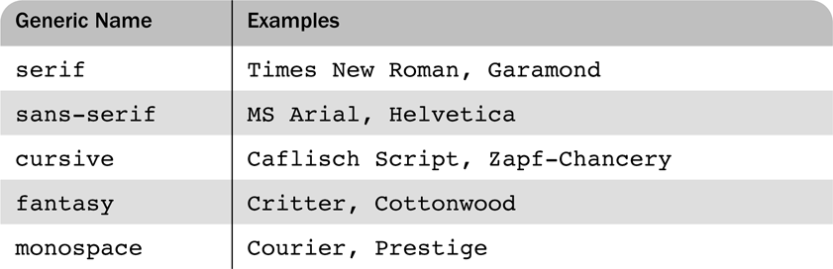
3.6 Font Properties (1)
font-family – specify font names
  Value is a list of font names – browser uses the first in the list it has
  e.g. font-family: Arial, Helvetica, Courier
  Generic fonts: serif, sans-serif, cursive, fantasy, and monospace (defined in CSS)
    Browser has a specific font for each generic name
    A good approach is to use a generic font as the last font in the value of a font-family property
  If a font name has more than one word, it should be single-quoted
Example3-2.html

Slide 12
3.6 Font Properties (2)
font-size – specify font size
  a length value or a name, such as smaller, xx-large, etc.
font-variant
  normal (default), small-caps (small capital characters)
font-style – used to specify italic
  italic, normal (default)
font-weight – specify the degree of boldness
  bold, normal (default), bolder, lighter, a multiple of 100 (100 – 900)
font – for specifying a list of font properties
  order must be: style, variant, weight, size, name(s)
  style, variant and weight can be in any order among themselves
  only size and name(s) are required
text-decoration – specify some special features of text
  line-through, overline, underline, none (default)
letter-spacing – specify space amount between characters
  any length value

Slide 13
3.7 List properties
list-style-type – specify presentation details of lists
Unordered lists – specify bullet types
  Bullet can be disc (default), square, or circle
  Set it on either the <ul> or <li> tag
  On <ul>, it applies to list items
  On <li>, list-style-type applies to just that item
  Could use an image for the bullets in an unordered list
    e.g. li {list-style-image: url(small_airplane.gif)}
Ordered lists – specify the types of sequence values
  Property value Sequence type First four values
  decimal Arabic numerals 1, 2, 3, 4
  upper-alpha Uppercase letters A, B, C, D
  lower-alpha Lowercase letters a, b, c, d
  upper-roman Uppercase Roman numerals I, II, III, IV
  lower-roman Lowercase Roman numerals i, ii, iii, iv
Example3-3.html

Slide 14
3.8 Colors
Color is a problem for the Web for two reasons:
  Monitors vary widely; browsers vary widely
There are three color collections
  Name colors: a set of 16 colors that are guaranteed to be correctly displayable by all graphical browsers on all color monitors
    black: 000000 green: 008000 silver: C0C0C0
    lime: 00FF00 gray: 808080 olive: 808000
    white: FFFFFF yellow: FFFF00 maroon: 800000
    navy: 000080 red: FF0000 blue: 0000FF
    purple: 800080 teal: 008080 fuchsia: FF00FF
    aqua: 00FFFF
  Web palette: 216 Web-safe colors
    Values for red, green and blue are restricted to 00, 33, 66, 99, CC, FF
    Allow all combinations of all increments of 20% of each basic color
  Any one of 16 million different colors represented by 24-bit numbers
color specifies the foreground color of elements
background-color specifies the background color of elements
Example3-4.html

Slide 15
3.9 Alignment of Text
The first line of a paragraph can be indented using the text-indent property
  Takes either a length value or a percentage value
The text-align property is used to arrange text horizontally
  Possible values: left (default), center, right, and justify
Sometimes we want text to flow around another element – the float property
  Possible values: left, right, and none (default)
  If we have an element we want on the right, with text flowing on its left, we use the default text-align value (left) for the text and the right value for float on the element
Example3-5.html

Slide 16
3.10 The Box Model (1)
Borders – every element has a border-style property
  border-style controls whether the element has a border and if so, the style of the border
  border-style values: none (default), solid, dotted, dashed, and double
  border-width specifies the thickness of a border
  border-width values: thin, medium (default), thick, and a length value in pixels
  border-color specifies the color of a border
  border-color values can be any color
  The above properties can be specified for any of the four borders (e.g. border-top-style, border-bottom-width, border-left-color)
Example3-5.html

Slide 17
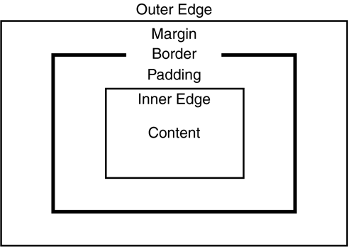
3.10 The Box Model (2)
Margin – the space between the border of an element and its neighbor element
  The margins around an element can be set with margin, margin-left, margin-right etc. – just assign them a length value
Padding – the distance between the content of an element and its border
  Controlled by padding, padding-left, padding-right etc.

Slide 18
3.11 Background Images
The background-image property is used to place an image in the background of an element
  e.g. body {background-image: url(c172.gif)}
The background image is replicated as necessary to fill the area of the element
Repetition can be controlled by background-repeat property
  Possible values: repeat (default), no-repeat, repeat-x, and repeat-y
The position of a nonrepeated background image can be specified with the background-position property
  Possible values: top, center (default), bottom, left, and right
  Use one keyword or a combination of two keywords like top left

Slide 19
3.12 The <span> and <div> tags
One problem with the font properties is that they apply to whole elements, which are often too large
  Solution: a new tag to define an element in the content of a larger element – <span>
  The default meaning of <span> is to leave the content as it is
  e.g. use <span> to apply a document style sheet to its content
  <style type = "text/css">
  .spanred {color: red}
  </style>
  … <p> computer <span class = "spanred"> science </span>
  technology </p> …
Another tag that is useful for style specifications: <div>
  Used to create document sections (or divisions) for which style can be specified
Example3-6.html

